Slide 1
PoveR-T Test Feature Selection and classification
William T. Bickelmann

Slide 2
Process overview
Preparation
Loading and joining
Cleaning
Feature Engineering and NA Omission
Training
LDA, FDA, Logistic Regression and Random Forest
Random Forest received best result
Submission
Joining of test data
Prediction and Isolation of submission variables

Slide 3
Going Forward
More models to try
Additional feature Engineering to employ

Slide 4

Loading and Joining the data
In order to train a model with the most predictive power, there must be a join between the individual data frame and data frame
Country B: 665 Variables and 3255 Observations
Country A: 386 Variables and 8203 Observations
Country C: 205 Variables and 6469 Observations

Slide 5
Addressing Columns with High number of nas
Get Rid of NAs
Address columns with high amount of NAs by removing them
Once columns with over 10 percent NAs removed, then remove rows with observations with NAs with na.omit()

Slide 6

Elimination of low variance variables
nearZeroVar() diagnoses predictors that have one unique value or close

Slide 7
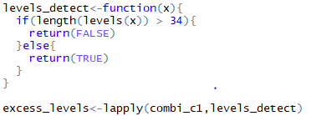
Deleting variables which will interfere with classification
Eliminate variables with categories over 34 which will stop algorithms from running

Slide 8
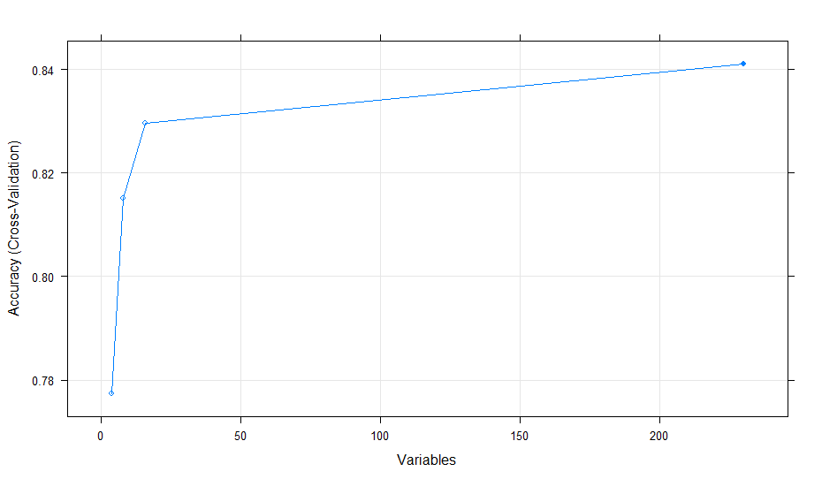
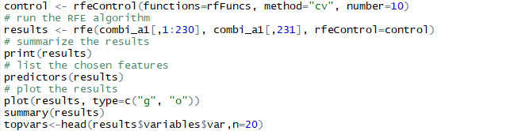
Recursive Feature elimination
Recursive feature elimination rfe() to get rid of more variables

Slide 9
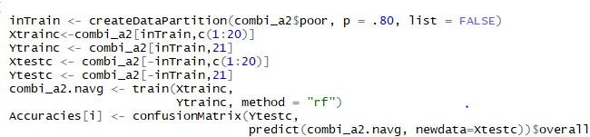
Training a model
Models used:
LDA
FDA
LOGISTIC
RANDOM FOREST

Slide 10
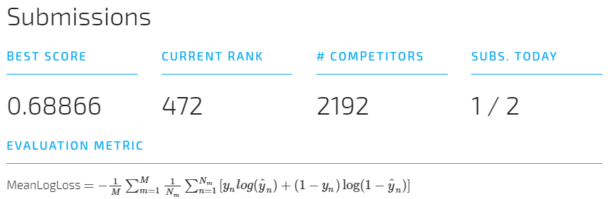
Results!
Random Forest Achieved best result

